Slide 1
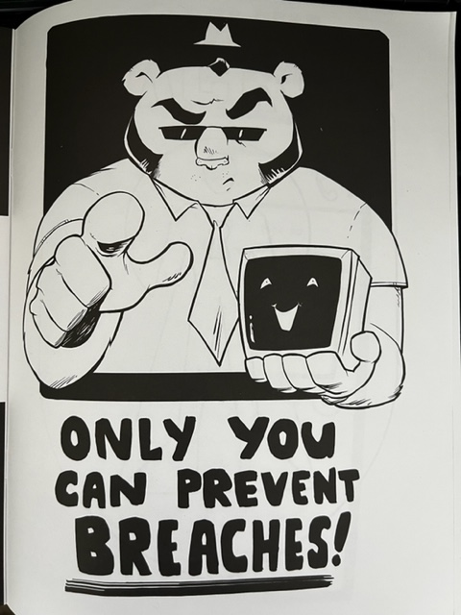
Misconfigurations Cyber Criminals hope you missed.
...
Source picture: Black Hills Info Security
Notes:
Spreadsheet of Tools/Projects:
https://docs.google.com/spreadsheets/d/1PLm37YWcV9dAwEAPx5p71aL2DtW3wJBzwRfMjdetcwQ/edit?usp=sharing
Verizon DBIR: 2022-data-breach-investigations-report-dbir.pdf (verizon.com)

Slide 2
Disclaimer
Following presentation contains my thoughts, ideas and opinions. They do not represent those of my current or past employers.
Any events, characters and company depicted in the course of this presentation are purely fictitious. Any similarity to actual events, characters and company is merely coincidental. <-Like South Park!
Do not use these tactics/techniques presented for evil.
Notes:
Example of Disclaimer:
CISA Compiles Free Cybersecurity Services and Tools for Network Defenders | CISA
This is not a comprehensive list of things...

Slide 3
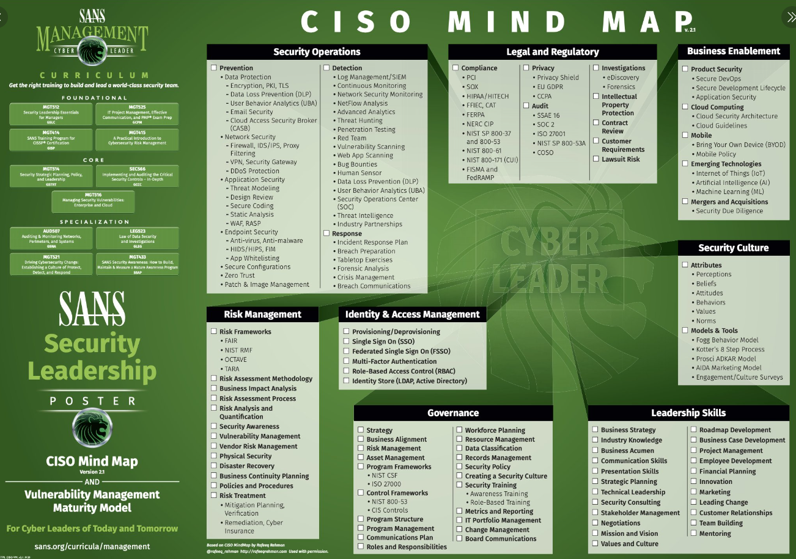
https://tinyurl.com/cisotweet
Notes:
SANS Institute on Twitter: "Do you have the latest SANS #cybersecurity posters like this gem, #CISO Mind Map, from SANS Security Leadership? Download your copy: https://t.co/EGtTUwZEFr https://t.co/ruc8cu85sI" / Twitter
https://twitter.com/SANSInstitute/status/1263825718024310784/photo/1

Slide 4
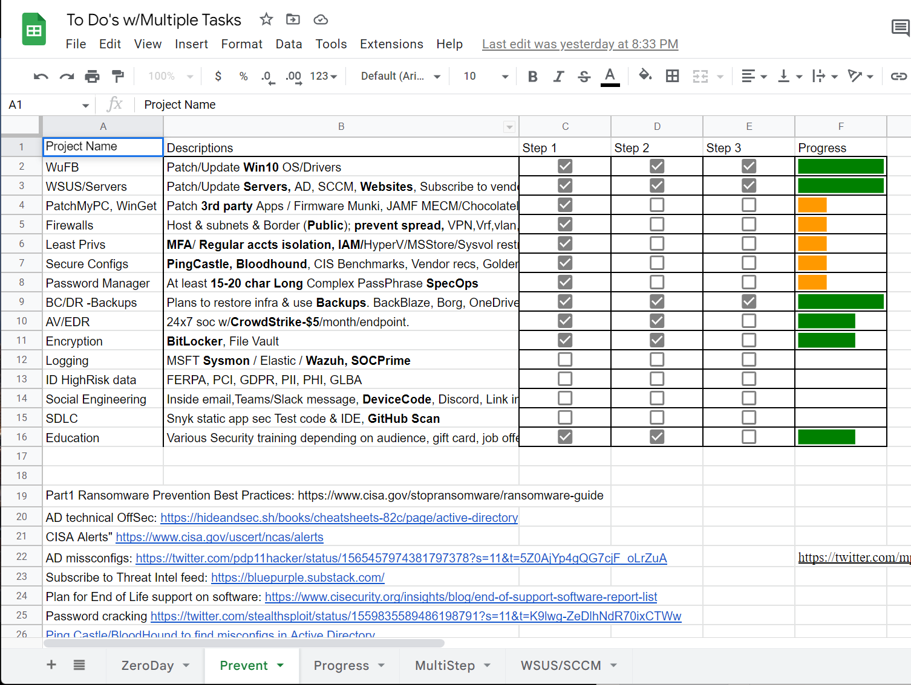
Security Tools Projects
https://tinyurl.com/xlsProj
Notes:
UW GoogleSheets:
https://docs.google.com/spreadsheets/d/14SuyZOHVYs3PnGzfu_sTUigj2LVNbl02fkV0HtJ6fnA/edit?usp=sharing
Ransomware Protection in Windows
Sophos Central – IT Connect (uw.edu)
End-of-Support Software Report List (cisecurity.org)
Time to Patch – Krebs on Security
Maybe look at Winget, AutoUpdate Windows, Ansible, Chocolatley, AutoPatch via Azure tenant/inTune
Vulnerability Summary for the Week of August 15, 2022 | CISA
Cyber Defence News for Blue & Purple Teams | Ollie | Substack
Whats Shodan or Censys.io look like for your Public IPs?
https://holisticinfosec.blogspot.com/2016/12/the-dfir-hierarchy-of-needs-critical.html
FuzzySecurity/WWHF-WayWest-2022 at fba2475d2f8dc7b7999cc5994ac340ca1db62090 (github.com)

Slide 5
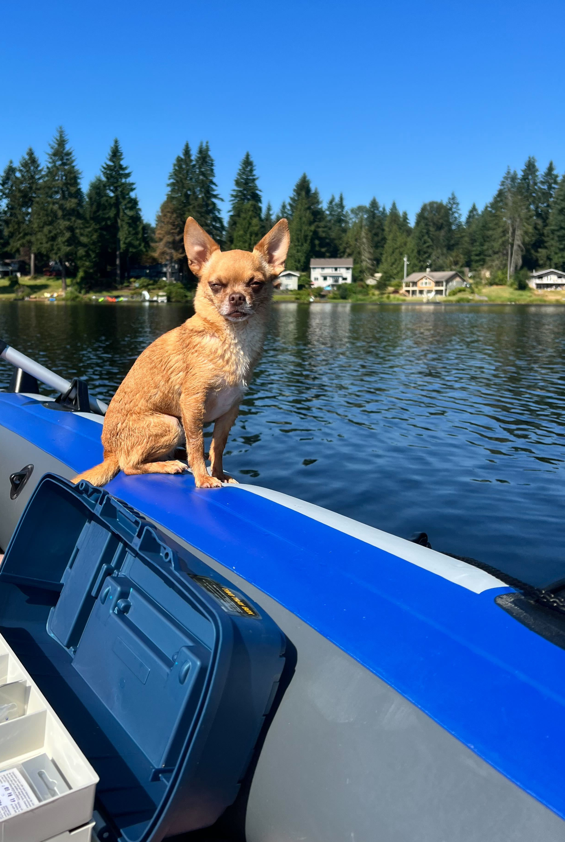
Who is this?
Currently:
Proud Pet Parent!!! -->Rocky
Past:
Pentest, Forensics, Incident Response
SIEM-As-A-Service
Vulnerability-As-A-Service
Admin at Nintendo for 10 years
Education:
Master of Science, Cybersecurity & Info Assurance
50+ Industry Certifications
https://www.linkedin.com/in/jessefmoore/
Notes:
Stories/Reasons: I am A..., Who Helps..., Because...
Email everyone you know letting them know you would never ask for gift cards or wire transfers
Security is my after work hobby, so I am passionate about it.

Slide 6
Agenda
Patching is Cool
Admin Creds are not cool
Workshop material for Admins
Notes:
Stories/Reasons: I am A..., Who Helps..., Because...
Email everyone you know letting them know you would never ask for gift cards or wire transfers
Security is my after work hobby, so I am passionate about it.

Slide 7
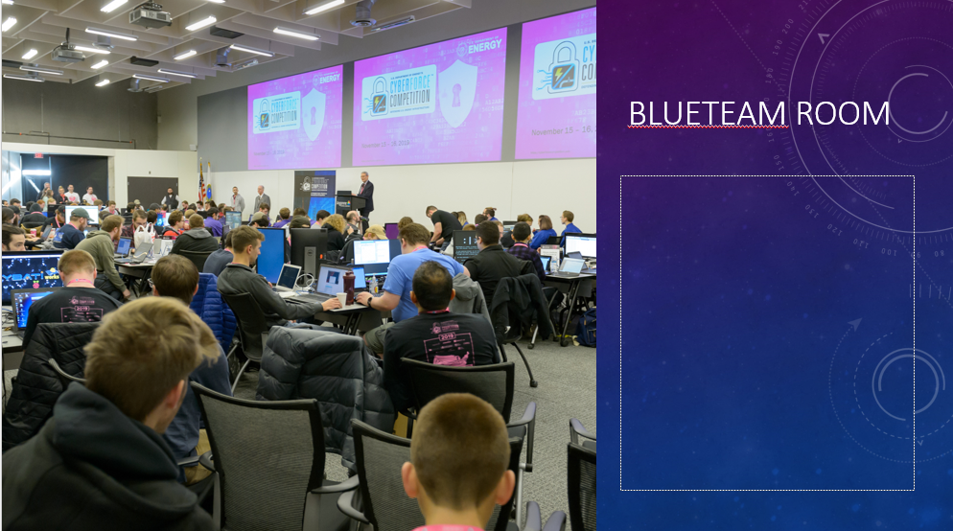
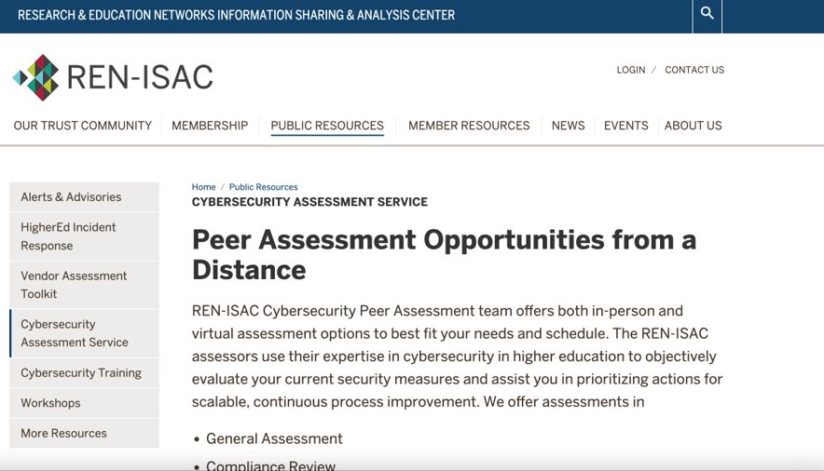
What has Jesse Been up to?
Since we last met…
I’ve been working on building CyberForce Comp.
https://tinyurl.com/cybforce
REN-ISAC Pentester
CISO workshops; https://ciso.uw.edu/education/outreach/workshops/#badthings
Notes:
CyberForce: Velociraptor, Blueteam Defense tools against Red and Dev Red Team vulns
Training; Phish with device codes, Setup C2 and obfuscate payload, and how to enum Teams and Search email.

Slide 8
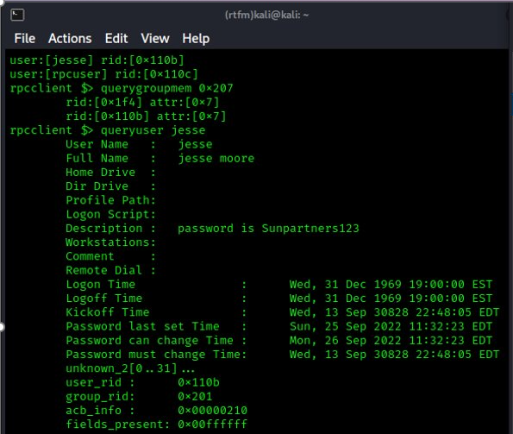
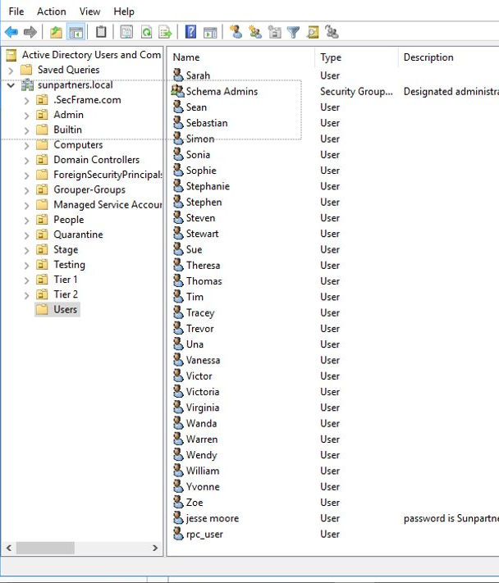
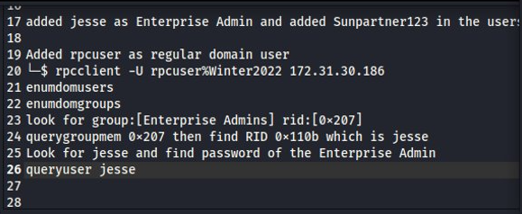
https://tinyurl.com/rpcuser
Notes:
https://screencast-o-matic.com/watch/c36QVQVtUY2
https://tinyurl.com/rpcuser

Slide 9
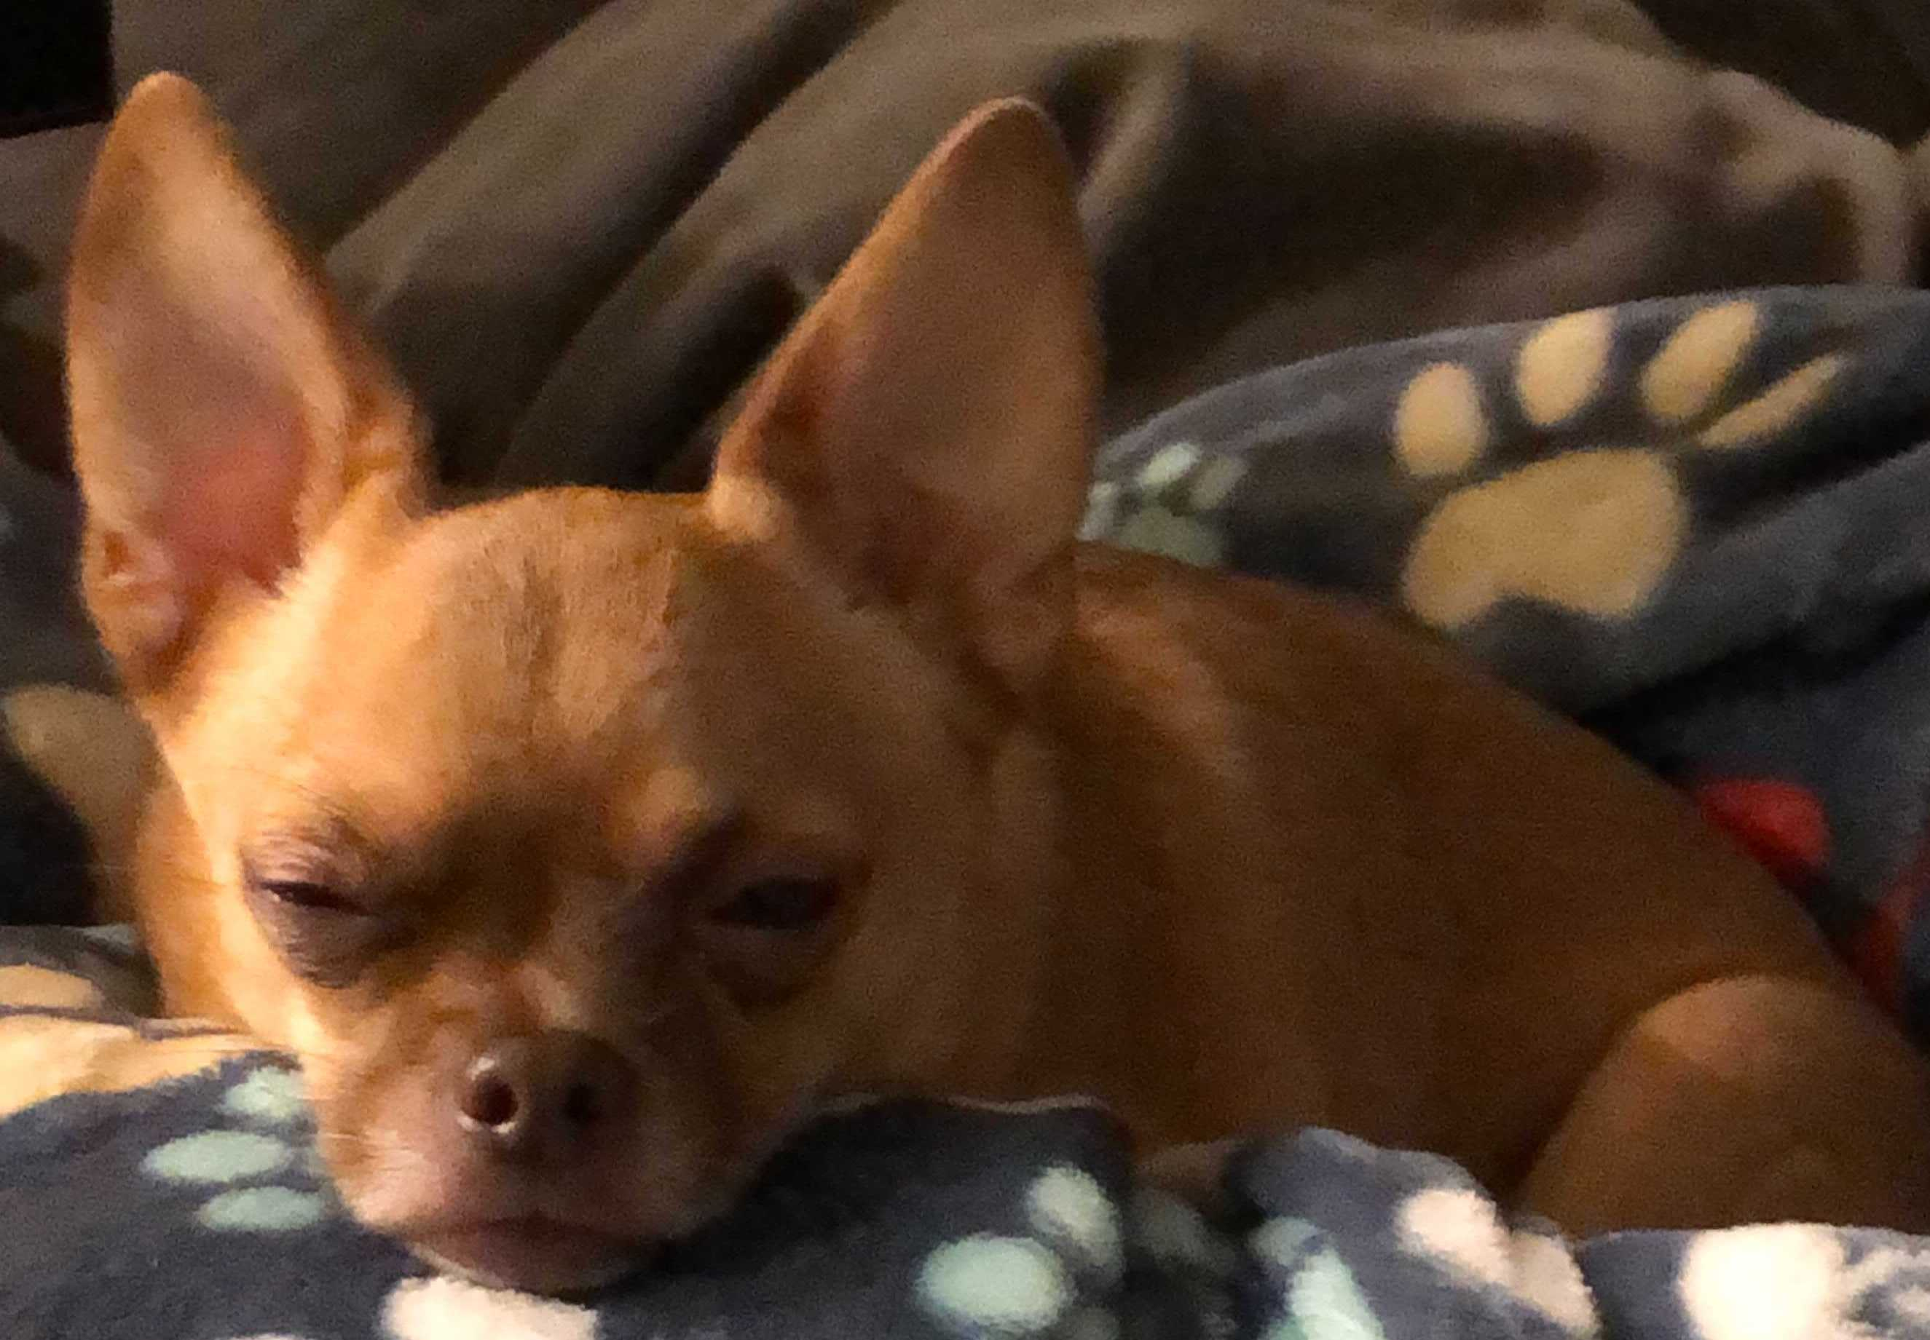
misconfig at Home?
Windows Update on​​​
Router/WiFi default pass, Firmware update
Turn on Encryption: File Vault & Bitlocker
Sophos Home https://home.sophos.com/en-us
OneDrive Cloud: https://screencast-o-matic.com/watch/c3Qv34VtipM
Notes:
OneDrive Recovery:
https://screencast-o-matic.com/watch/c3Qv34VtipM
Restore from BackBlaze:
https://screencast-o-matic.com/watch/c3QuqvVtcqw
Sophos Home
https://home.sophos.com/en-us
Borg Backup for Linux
https://borgbackup.readthedocs.io/en/stable/installation.html

Slide 10
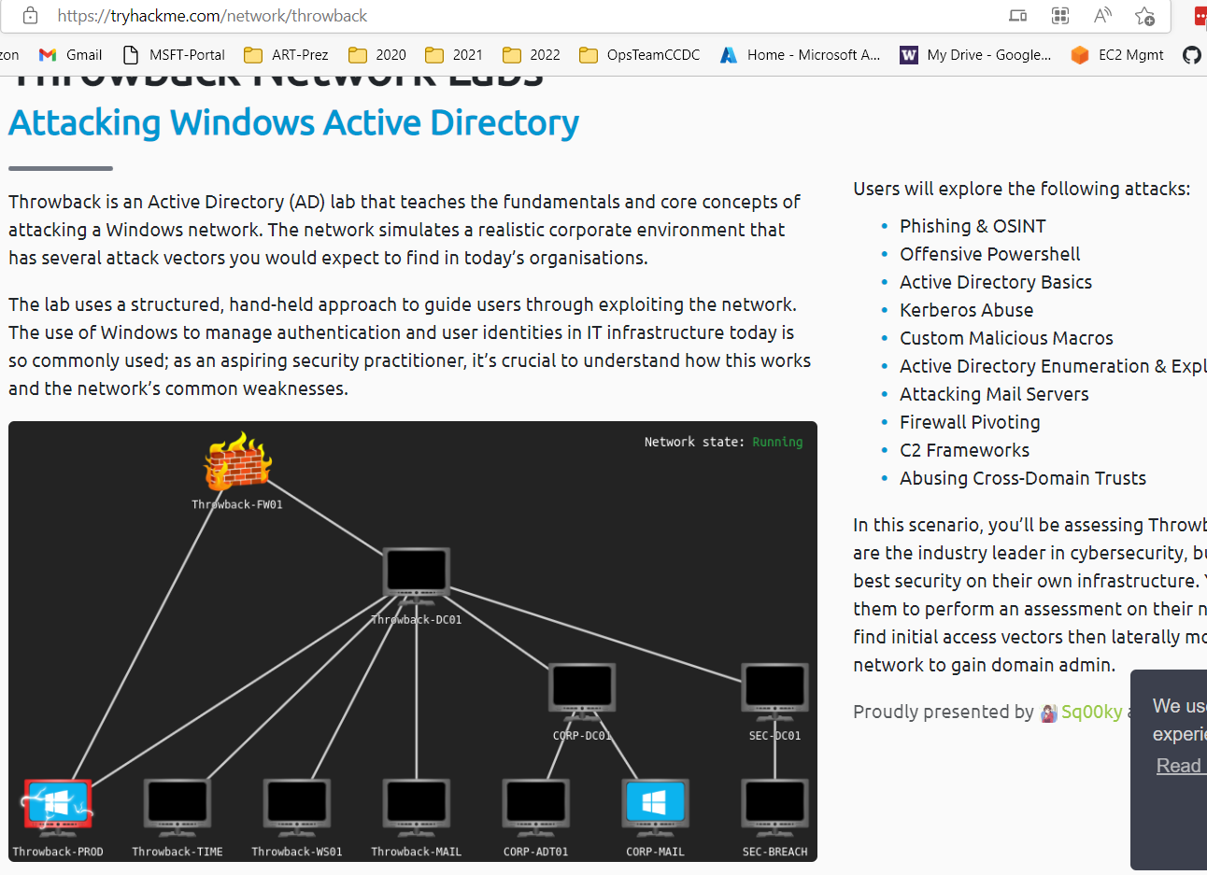
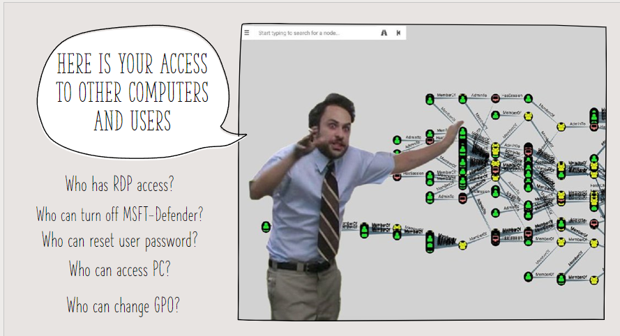
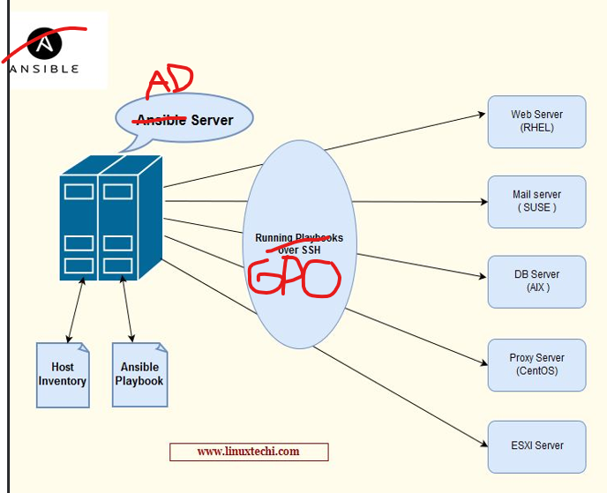
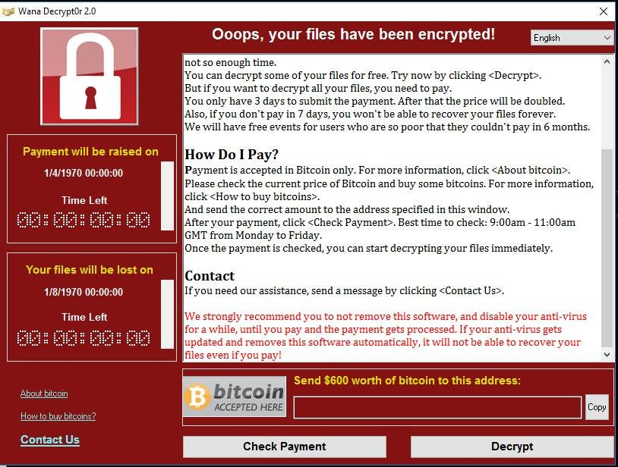
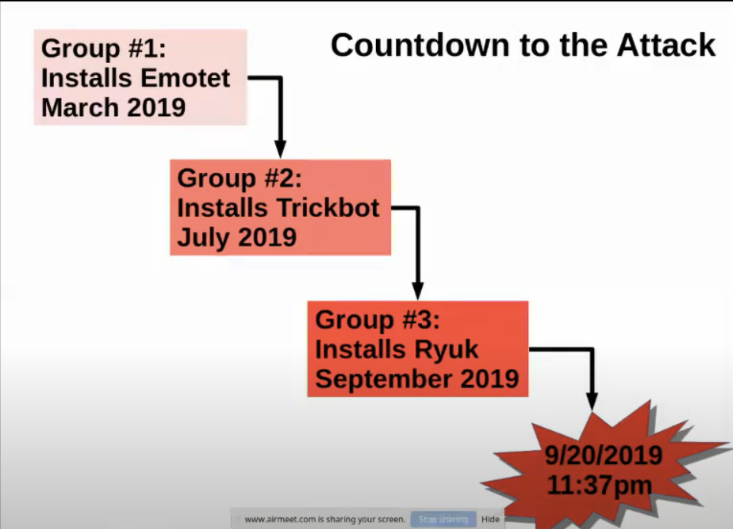
School Active Directory hit by Ransomware! TIPS!!!
what about all the steps while they are in?
Northshore School district System admins share their experience: https://tinyurl.com/NSRan
Notes:
files/translate_f.pdf at main · silence-is-best/files (github.com)
https://tinyurl.com/NSRan
The hateful eight: Kaspersky’s guide to modern ransomware groups’ TTPs | Securelist
Jessica from Microsoft (IR at the time):
https://twitter.com/jepaynemsft/status/1255991971845308416
https://attack.mitre.org/groups/

Slide 11
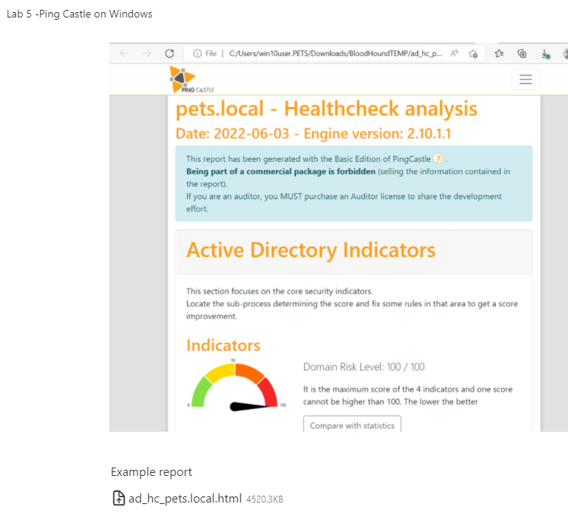
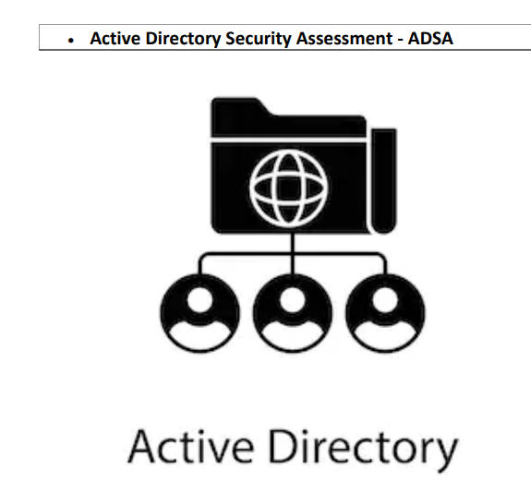
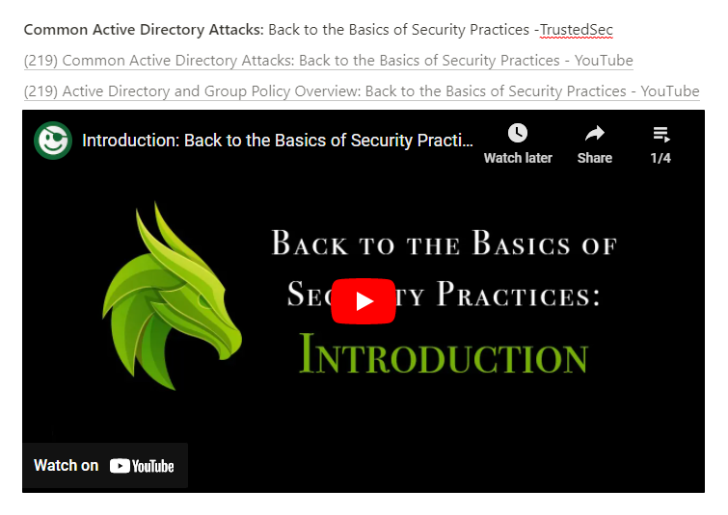
AD Assessment
https://tinyurl.com/WSBloodHound
https://tinyurl.com/ADefence
Notes:
TrustedSec -Back to the Basics of Security Practices
https://www.youtube.com/watch?v=dJT2pVNAbfA&list=PLk-dPXV5k8SEtiTgi9wgxmDS0CCZQur6H
PingCastle AD Assessment
https://www.pingcastle.com/download/
Active Directory On-Demand Assessment
https://learn.microsoft.com/en-us/services-hub/health/getting-started-ad

Slide 12
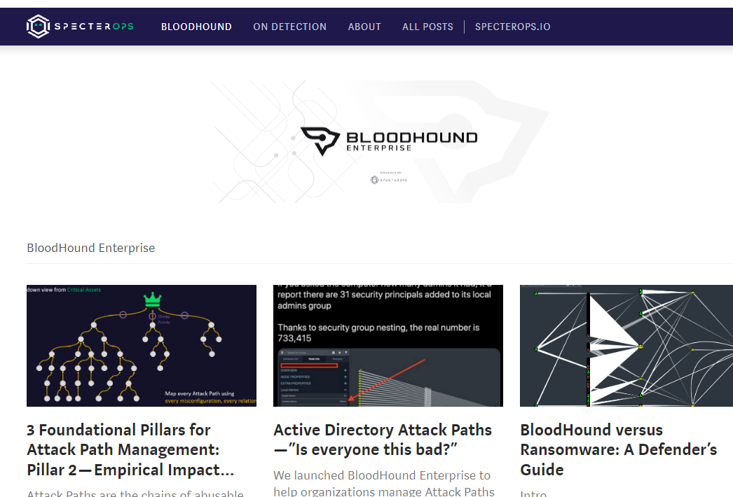
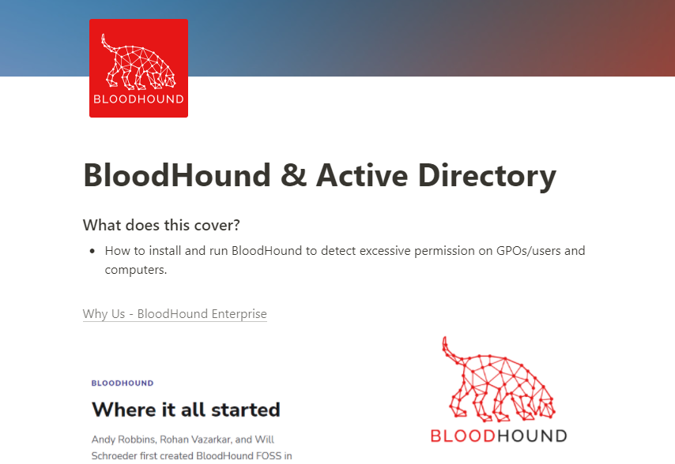
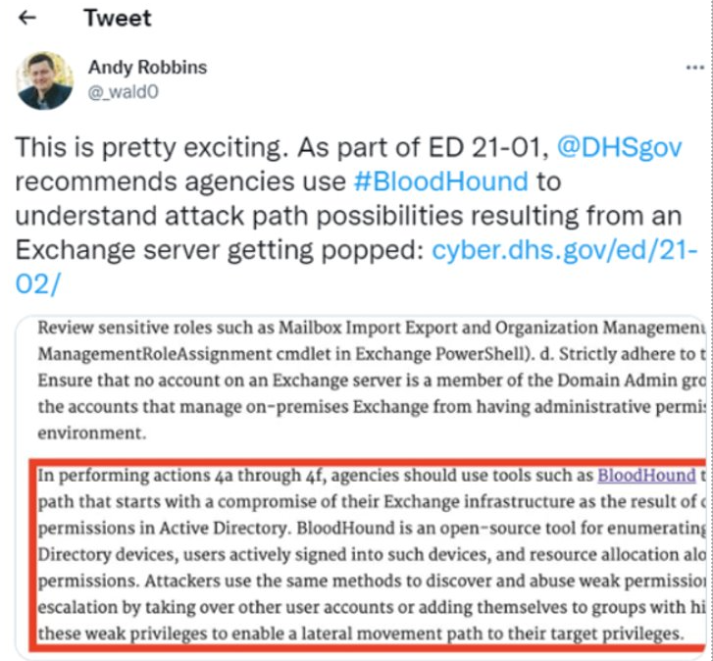
AD Assessment Part 2
https://tinyurl.com/WSBloodHound
Notes:
https://grizzly-dibble-cdb.notion.site/BloodHound-Active-Directory-8771c2bd8f11403cbd108b83d97f3053

Slide 13

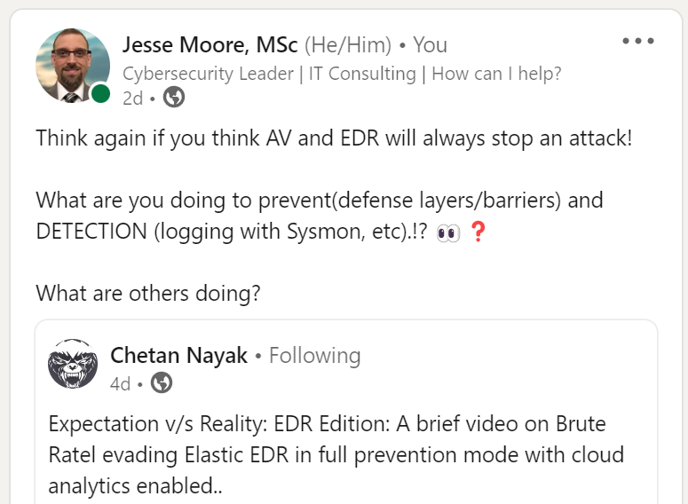
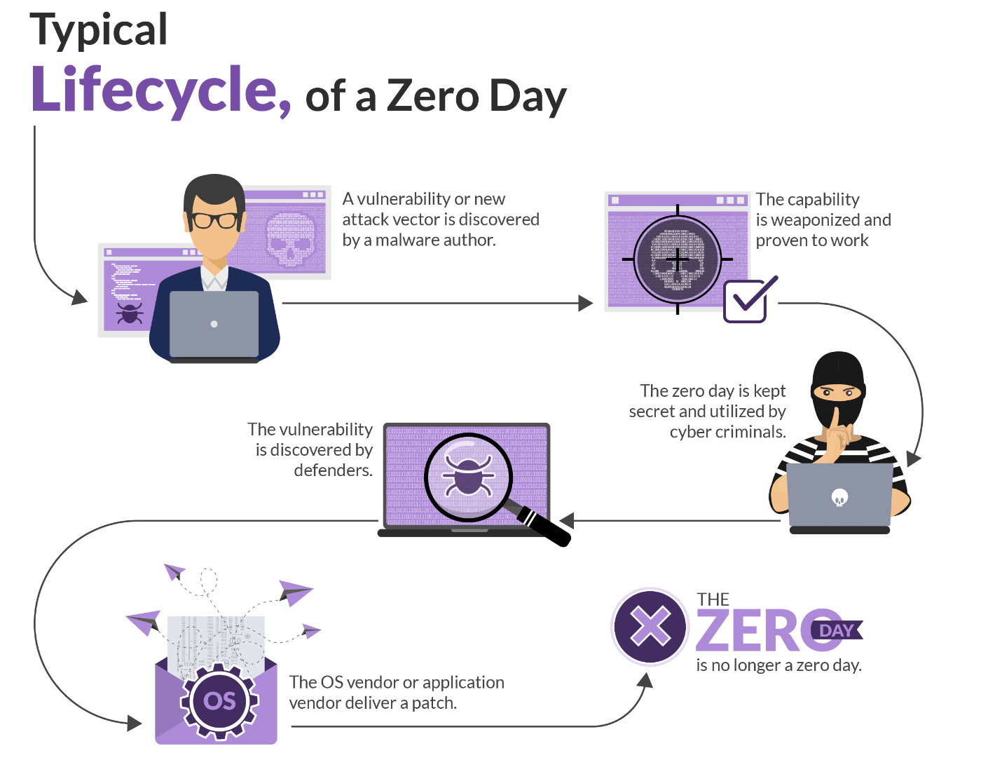
Go over an attack
https://thedfirreport.com/
https://tinyurl.com/BruteRatel
Notes:
https://thedfirreport.com/
Brute Ratel:
https://www.youtube.com/watch?v=hAHkJSPCc2A

Slide 14
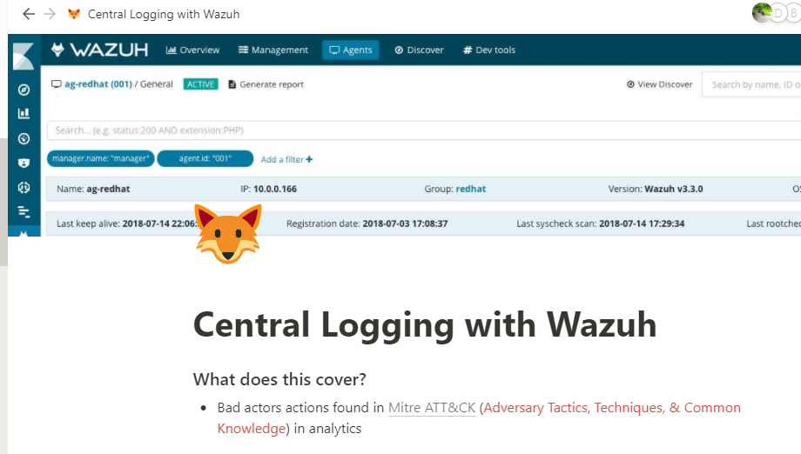
If its not logged it didn’t happen!
Need the right data aka such as Sysmon
https://tinyurl.com/wazuhWS
Notes:
https://grizzly-dibble-cdb.notion.site/Central-Logging-with-Wazuh-278119388a16411e9cf2ae6ba39a90c8
The DFIR Report – Real Intrusions by Real Attackers, The Truth Behind the Intrusion
Sept 6th
Over the past several years, the education sector, especially kindergarten through twelfth grade (K-12) institutions, have been a frequent target of ransomware attacks
The 18 CIS Critical Security Controls (cisecurity.org)

Slide 15
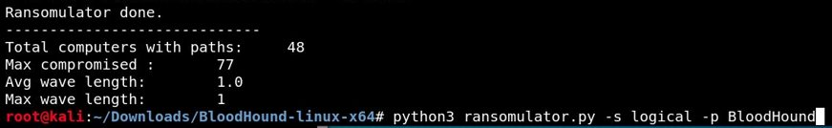
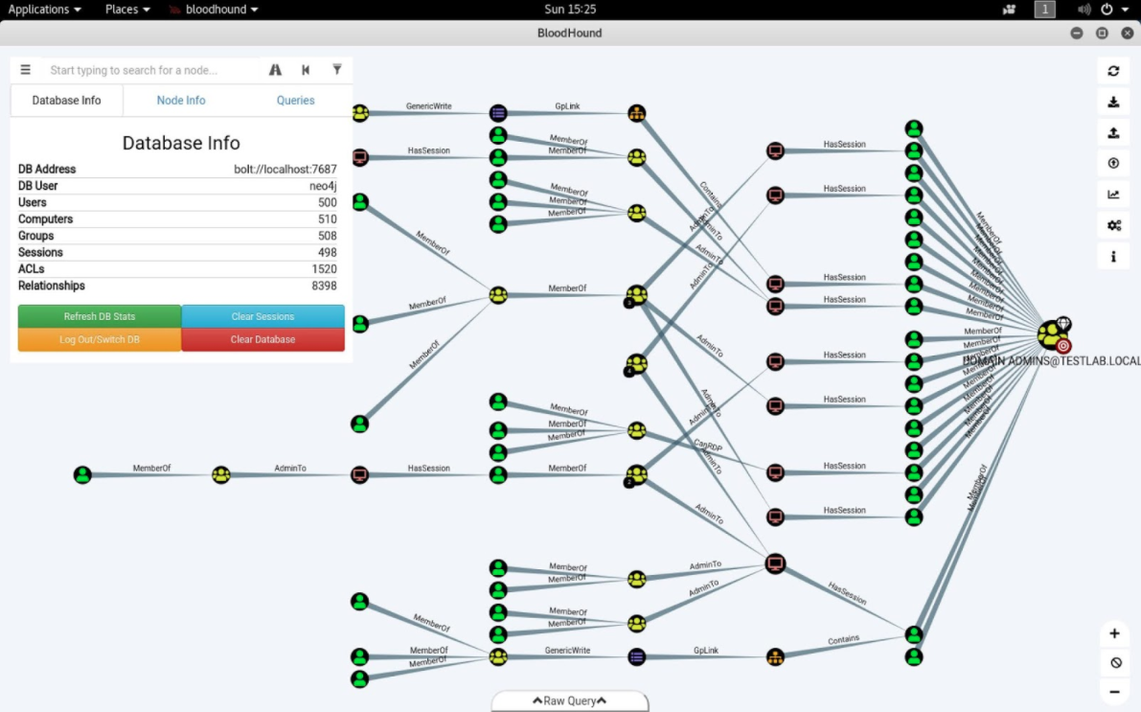
Who wants to Simulate Ransomware in Active Directory???
https://tinyurl.com/RansomWS
Notes:
Exchange and BloodHound maps...
04262018-Webcast-Toxic-Waste-Removal-by-Andy-Robbins.pdf (blackhat.com)
AD Mitigations:
https://www.youtube.com/watch?v=vga7A2tYejE&t=5s
Simulate Ransomware: sudo git clone https://github.com/zeronetworks/BloodHound-Tools/tree/main/Ransomulator sudo apt-update sudo apt-upgrade sudo apt-get install python3-pip sudo apt-cache madison neo4j python3 -m pip install neo4j python3 -m pip install neo4j-driver pip3 install cornershot root@kali:~/Downloads/BloodHound-linux-x64/BloodHound-Tools/ python3 ransomulator.py -p BloodHound

Slide 16
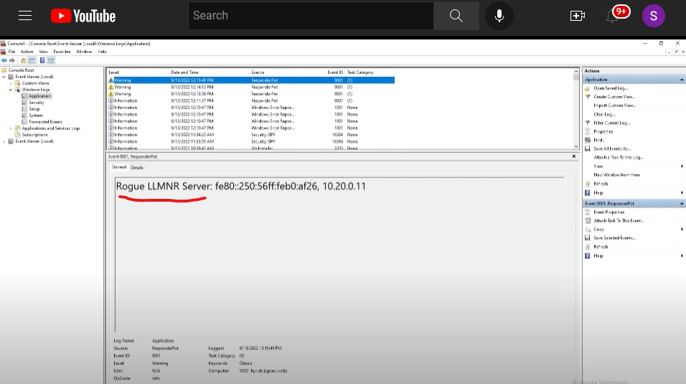
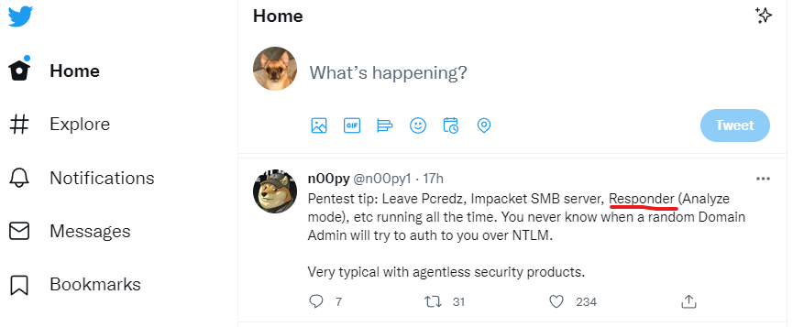
AD- Early warning detection system (LLMNR)
https://twitter.com/jessefmoore
https://tinyurl.com/EarlyDetections
Notes:
(19) Detecting Responder via LLMNR Honey Tasks on User Workstations – YouTube
https://www.youtube.com/watch?v=h_cWWL-yyb0&t=295s
Twitter Defender: https://twitter.com/GossiTheDog/status/1578313384298094592?s=20&t=I8HGr3JHIo-7XCneXSZmOQ
Me using Impacket: https://screencast-o-matic.com/watch/c3QIFGVOFmz
Hacker Methodology handbook
TRÄW🤟 on Twitter: "6. "Hacker Methodology Handbook" by Thomas Bobeck https://t.co/LbFW8LmgOP" / Twitter
Twitter API:
https://screencast-o-matic.com/watch/c3QFqHVOwRy
Twitter Pentester/Red Teamer:
https://twitter.com/n00py1/status/1577045510036557824
Responder:
https://screencast-o-matic.com/watch/cqiveFOp0E
Slack to Responder:
https://screencast-o-matic.com/watch/cYfV024AGF
TableTop Exercise
https://bnb.silverday.de/

Slide 17
Admin Tools ; slow down hacker... to ease your mind...when news hits!
WSUS Patch servers
Password Managers
WuFB Patch oS/Drivers WS
DR/BC to Recover from incident
Bitlocker, Filevault prevent lost data
PatchMyPC 3rd party Apps
EDR, Anti Virus​​ (turn off AV?)
SCCM/MECM Software update/Patch
Logging (Wazuh, Elastic, splunk, Sentinel, Azure Log Analyzer) find malicious/audit
2FA Apps/Email MalSpam Filters
End Of Life software
Firewall on Host & Network for Public/Private
Pentest high impact (finable, etc) systems
LAPS && Separate admin w/Regular
Notes:
End-of-Support Software Report List (cisecurity.org)
Vulnerability Summary for the Week of August 15, 2022 | CISA
Cyber Defence News for Blue & Purple Teams | Ollie | Substack
Time to Patch – Krebs on Security
Whats Shodan or Censys.io look like for your Public IPs?
https://holisticinfosec.blogspot.com/2016/12/the-dfir-hierarchy-of-needs-critical.html
FuzzySecurity/WWHF-WayWest-2022 at fba2475d2f8dc7b7999cc5994ac340ca1db62090 (github.com)
Win update;
Winget
Chocolatey
How to Enable or Disable Ransomware Protection in Windows 10 & 11 - MajorGeeks
CIS Endpoint Security Services via CrowdStrike Terms & Conditions (cisecurity.org)

Slide 18
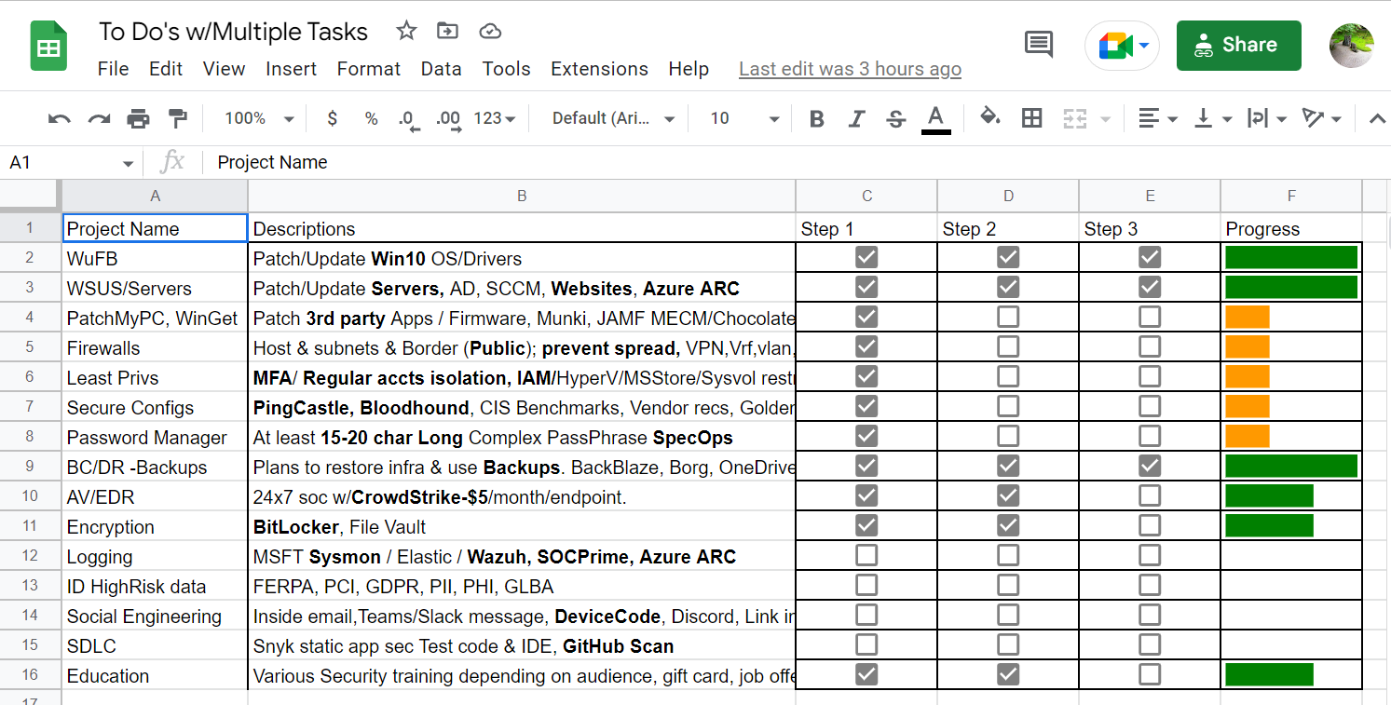
What's Connected to AD? Need Security Tools Projects?
https://tinyurl.com/xlsProj
Notes:
ASSUME EMAIL FILTERS... ProofPoint etc.
Assumes Exchange fixed.
@_wald0 azure github
End-of-Support Software Report List (cisecurity.org)
Time to Patch – Krebs on Security
Maybe look at Winget, AutoUpdate Windows, Ansible, Chocolatley, AutoPatch via Azure tenant/inTune
Vulnerability Summary for the Week of August 15, 2022 | CISA
Cyber Defence News for Blue & Purple Teams | Ollie | Substack
Whats Shodan or Censys.io look like for your Public IPs?
https://holisticinfosec.blogspot.com/2016/12/the-dfir-hierarchy-of-needs-critical.html

Slide 19
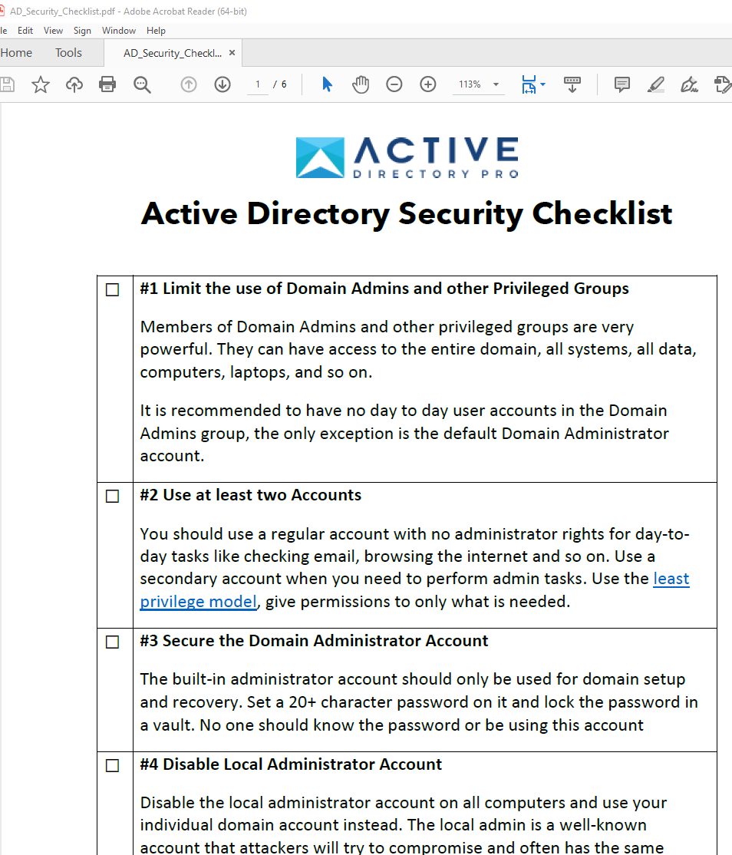
Checklist –Top 25
https://activedirectorypro.com/active-directory-security-best-practices/

Slide 20
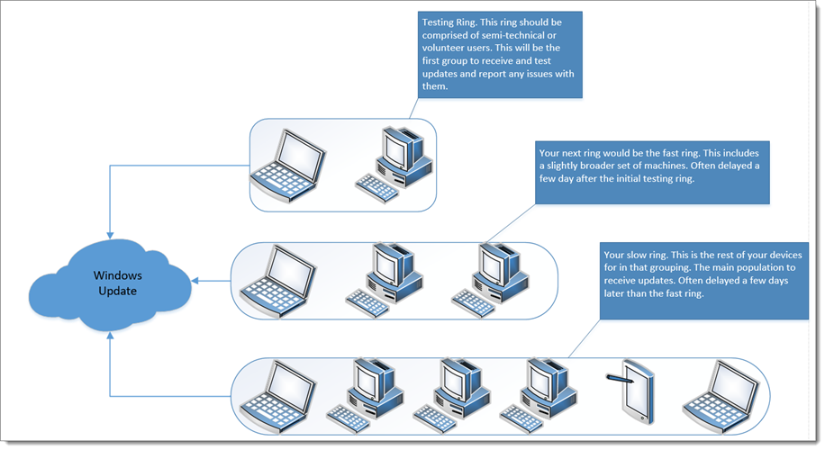
Windows Update for Business for Win10
https://www.policypak.com/resources/pp-blog/windows-update-business/
Notes:
https://www.policypak.com/resources/pp-blog/windows-update-business/

Slide 21
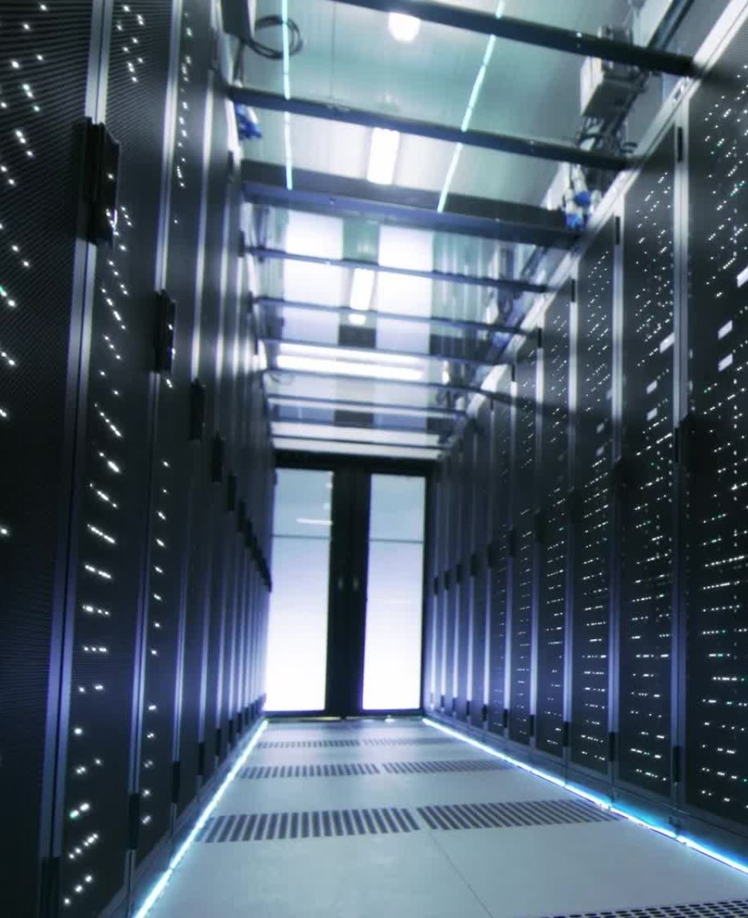
WSUS for servers OR Chocolatey OR Azure ARC
How to Install Chocolatey Package Manager on Windows Server - Serverspace.us
Notes:
https://serverspace.us/support/help/secured-windows-server-checklist/
https://community.chocolatey.org/packages/KB3063858#install

Slide 22
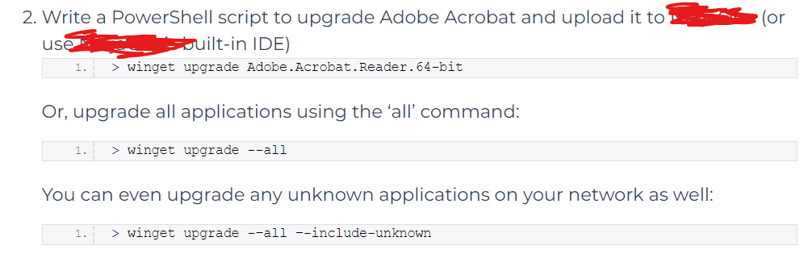
Winget for 3rd party apps
https://www.ninjaone.com/blog/how-to-use-winget-install-software-remotely/

Slide 23
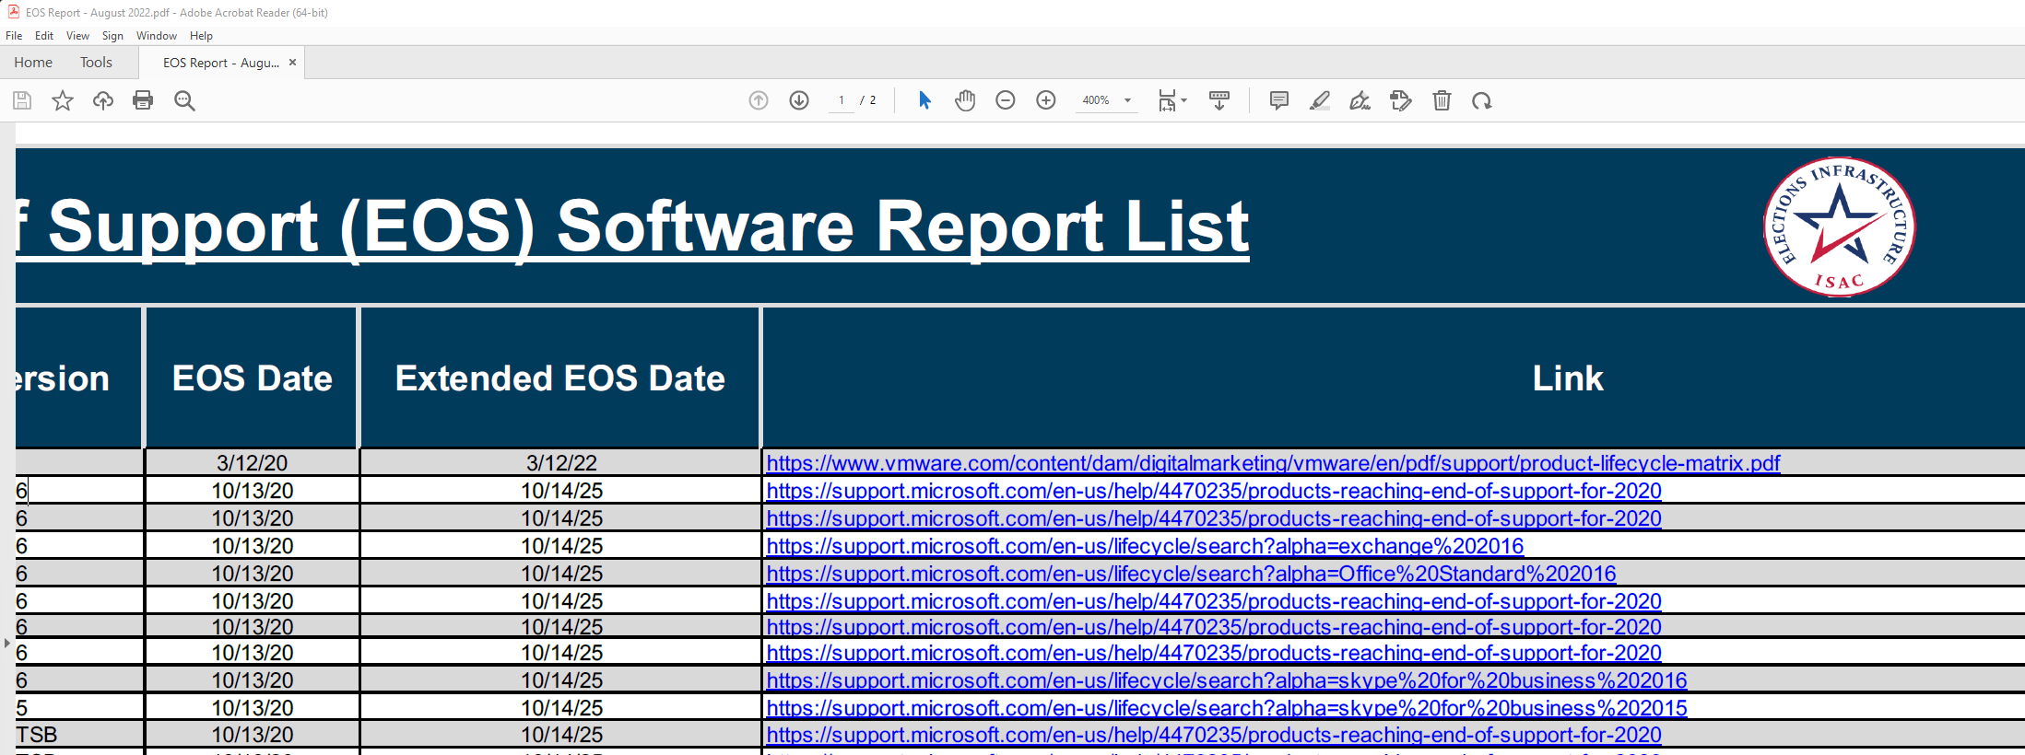
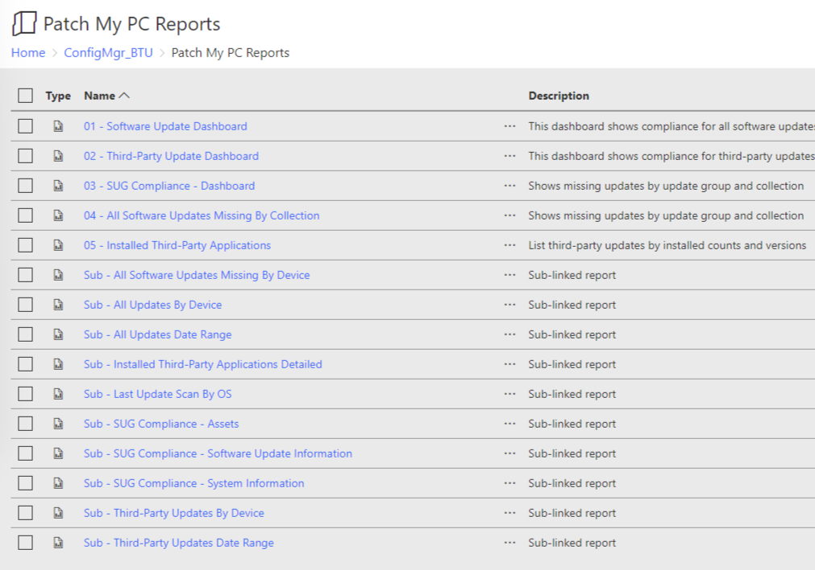
End of Support Report, & PatchMyPC
End of Support software report list from Center for Internet Security.
https://www.cisecurity.org/insights/blog/end-of-support-software-report-list
PatchMyPC Reports.
https://patchmypc.com/free-software-update-compliance-dashboard-reports-for-microsoft-sccm

Slide 24
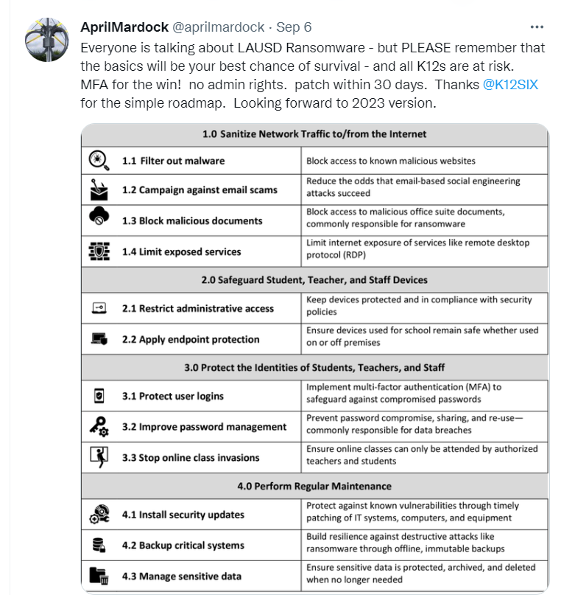
K12 -No Admin Use LAPS
Twitter AprilMardock K12
https://twitter.com/aprilmardock/status/1567316804112109568?s=20&t=LtkvmoLC8T9IT2ZMT95cwA
Notes:
https://www.k12six.org/essentials-series-resources-2022
K12SIX-SETDA-K12CybersecurityFrameworks.pdf - Google Drive

Slide 25
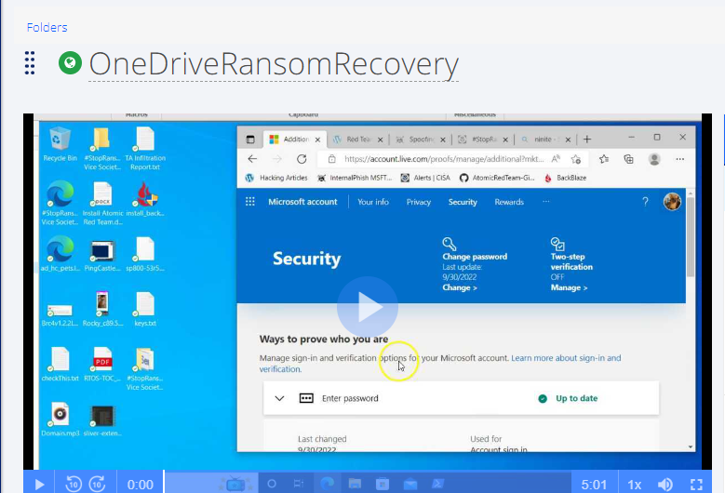
Backups?
Azure Backups
Linux Borg backups
OneDrive
https://screencast-o-matic.com/watch/c3Qv34VtipM
Notes:
OnedriveRansomRecovery
https://screencast-o-matic.com/watch/c3Qv34VtipM
Azure ARC (Automate updates):
(248) Use Microsoft Azure monitoring, security, and update services anywhere - YouTube

Slide 26
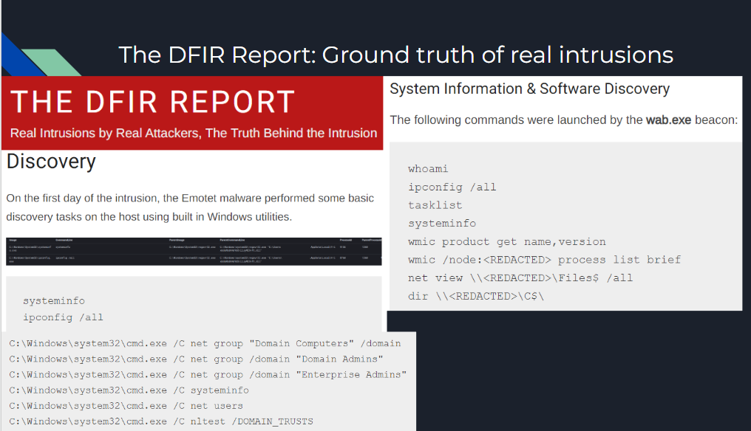
https://thedfirreport.com/2022/08/08/bumblebee-roasts-its-way-to-domain-admin/
Notes:
https://thedfirreport.com/2022/08/08/bumblebee-roasts-its-way-to-domain-admin/

Slide 27
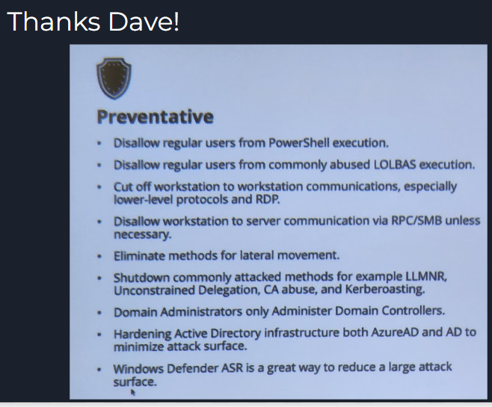
Prevent

Slide 28
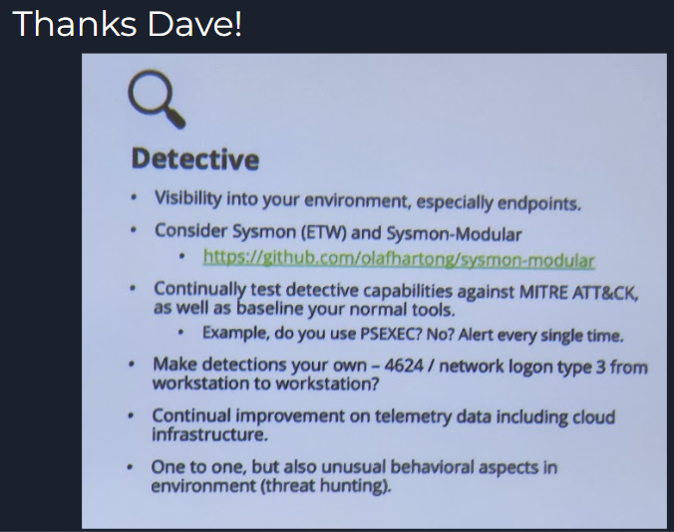
Detect

Slide 29
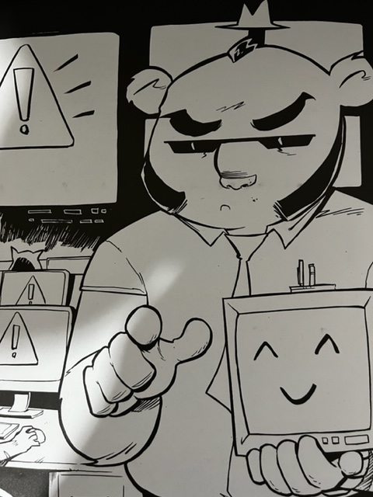
Take aways
Patch w/WuFB, 3rdParty, Azure ARC
Remove Admin rights where possible
-Use BloodHound to see how far permissions can go in a ransomware attack
Resources for Admins
- BloodHound
- Wazuh logging
-Checklist –top 25 AD security & Spreadsheet
SOURCE: https://www.blackhillsinfosec.com/prompt-zine/
OneDrive Access: https://tinyurl.com/JesseShare
Notes:
OneDrive access for slides and other stuff: https://tinyurl.com/JesseShare
MSFT AD Assessment
https://learn.microsoft.com/en-us/services-hub/unified/health/getting-started-adsecurity
Trimarc
https://www.hub.trimarcsecurity.com/post/securing-active-directory-performing-an-active-directory-security-review
SpecterOps
https://posts.specterops.io/attacking-azure-azure-ad-and-introducing-powerzure-ca70b330511a
Semperis
https://www.semperis.com/solutions/uncover-active-directory-attack-paths/
BlackHIllsInfosec
https://www.blackhillsinfosec.com/tag/active-directory/
PingCastle, PurpleKnight, BloodHound, GoodHound
CISA
https://csrc.nist.gov/projects/ransomware-protection-and-response
Take assessment: https://github.com/cisagov/cset/releases/tag/v10.3.0.0

Slide 30
Thank you!
Outside of work:
Look for me on disord dfir-jesseee
@jessefmoore on Twitter
Collab at work: moorej1@uw.edu
Notes:
Tips and Tactics: Ransomware (nist.gov)
Release Ransomware Readiness Assessment CSET v10.3 · cisagov/cset (github.com)
CIS CSAT Ransomware Business Impact Analysis tool: https://bia.cisecurity.org/?next=/dashboard/
https://home.treasury.gov/system/files/126/ofac_ransomware_advisory_10012020_1.pdf
https://iclg.com/practice-areas/sanctions/usa

